Slide 1


Slide 2
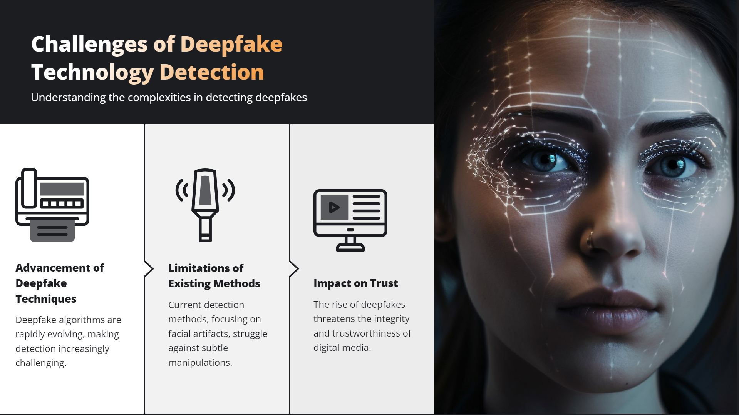

Slide 3
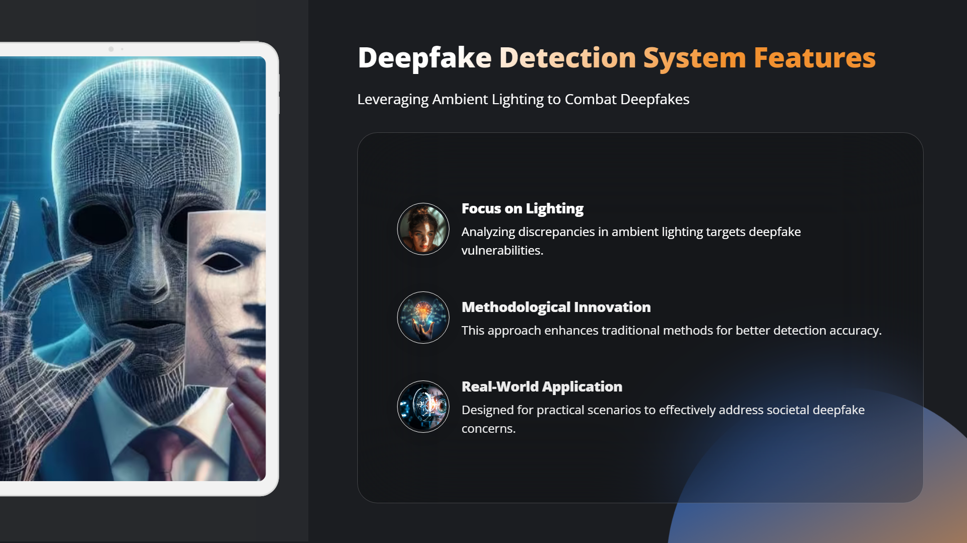

Slide 4
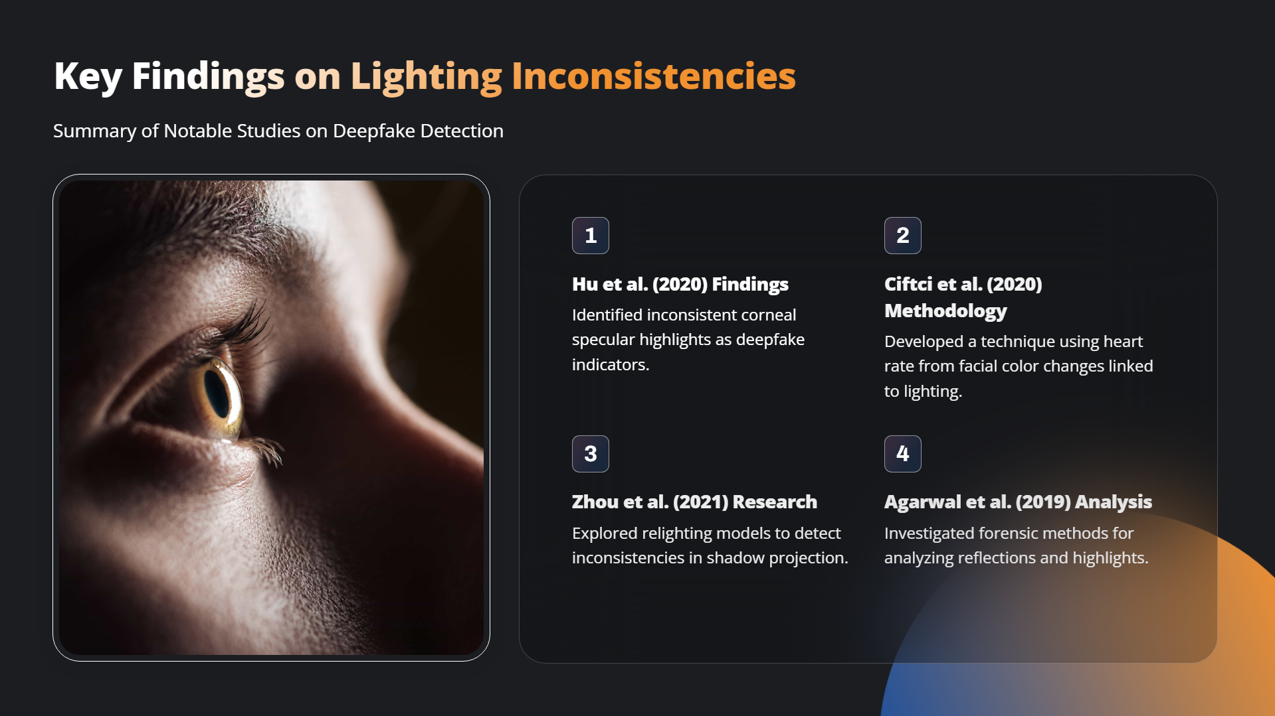

Slide 5
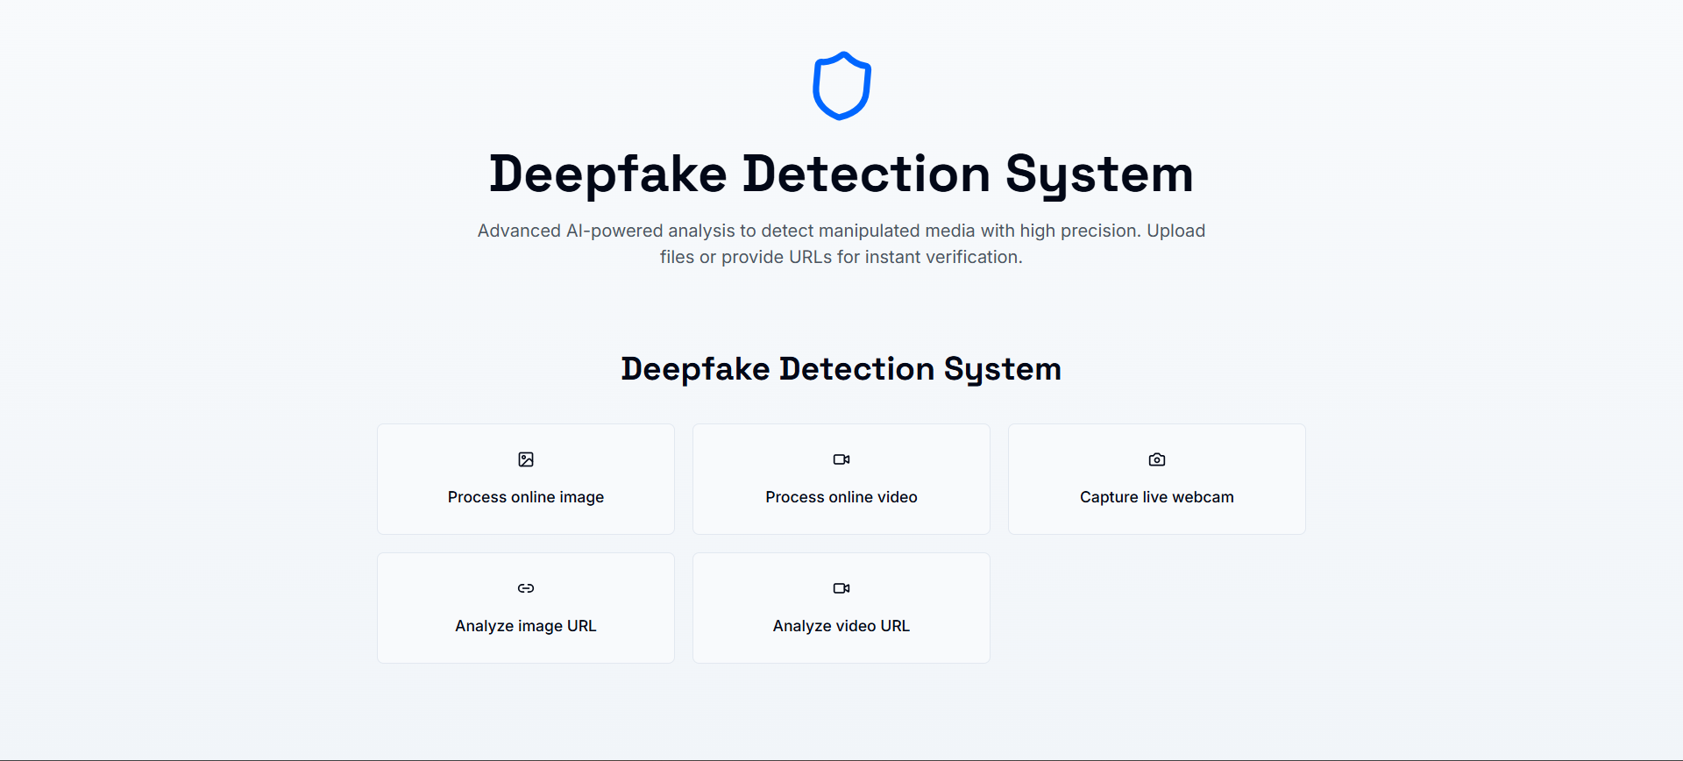
Proposed System
Deepfake Detection System Overview :
The Deepfake Detection System is an AI-driven solution designed to detect manipulated media with high precision. The system leverages deep learning techniques and computer vision algorithms to analyse images and videos, identifying synthetic alterations commonly found in deepfake content.
Key Features:
Process Online Image: Allows users to upload and analyse images for deepfake detection.
Process Online Video: Supports video file uploads to detect deepfake alterations.
Capture Live Webcam: Enables real-time deepfake detection using a webcam.
Analyse Image URL: Verifies images directly from a URL.
Analyse Video URL: Examines videos hosted online for authenticity.
The system offers an interactive user interface (UI) (Fig. 1) where users can upload or provide media URLs for instant verification.
Figure 1: User Interface of the Deepfake Detection System

Slide 6
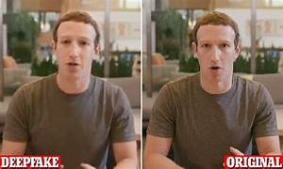
METHODOLOGY
2.1 Data Collection and Preprocessing
The dataset comprises real and deepfake images/videos collected from Face Forensics++, Celeb-DF, and other sources.
Preprocessing steps include:
Resizing images to standard dimensions.
Normalization of pixel values for consistency.
Data augmentation techniques (flipping, rotation, color jitter) to enhance model robustness
2.2 Model Architecture
The deepfake detection model is built using a CNN-based architecture with transfer learning from pre-trained models such as EfficientNet-B0 and xception Net, known for their high accuracy in image classification tasks.
Layers Used:
Convolutional Layers: Feature extraction from input images.
Batch Normalization & Dropout: Prevents overfitting.
Fully Connected Layers: Outputs classification as Real or Deepfake.
📌 Figure 2: Sample Preprocessed Images (Real vs. Deepfake)

Slide 7
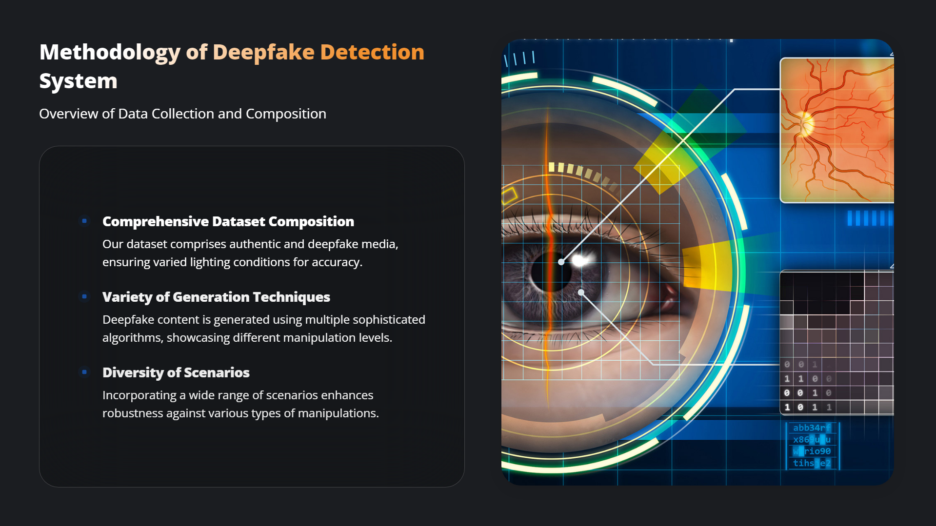

Slide 8
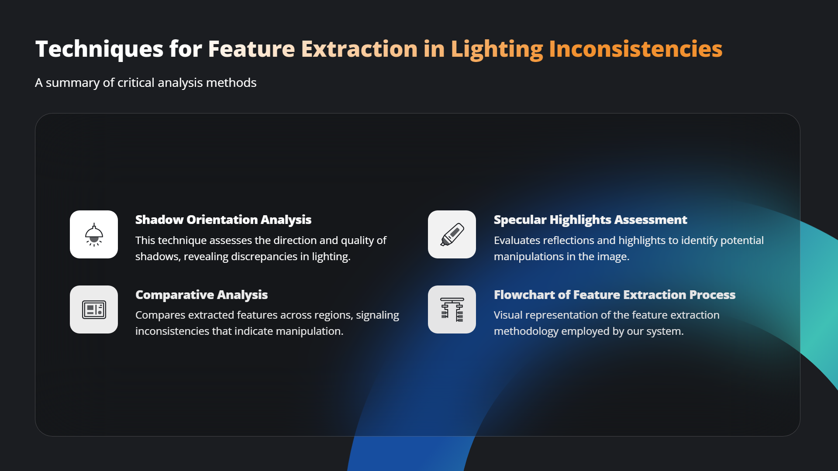

Slide 9
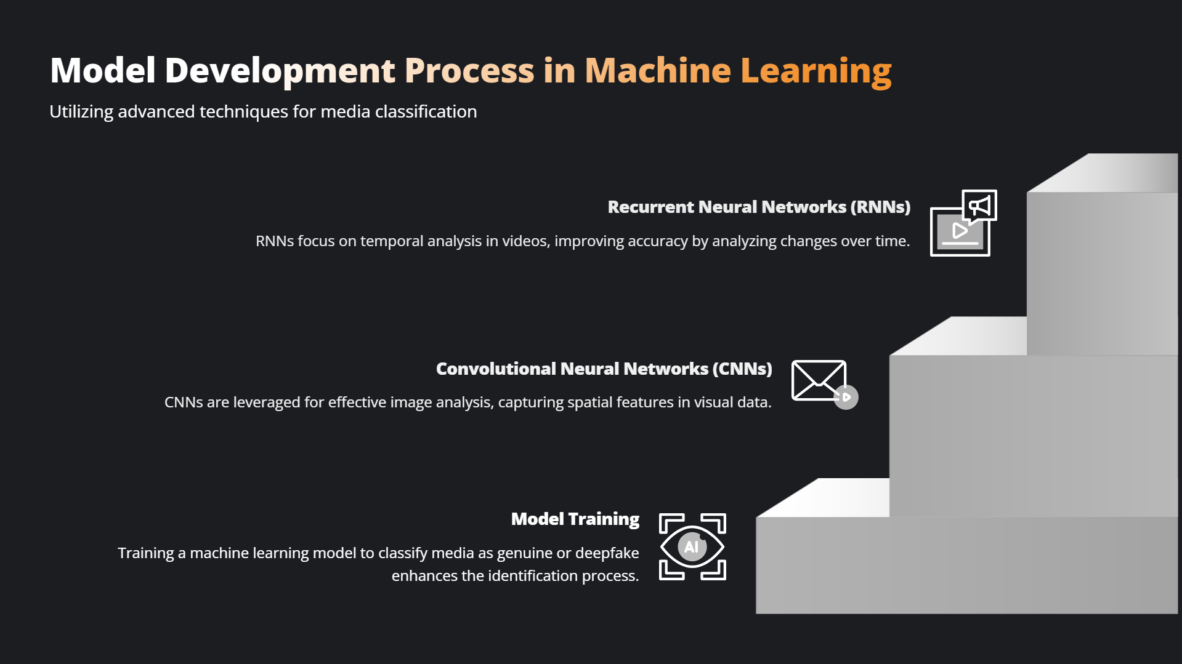

Slide 10
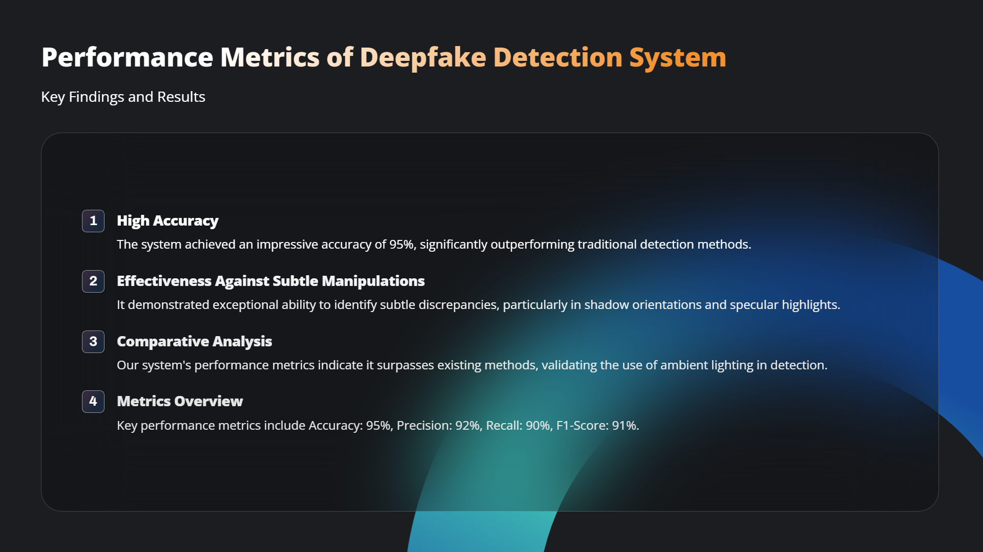

Slide 11
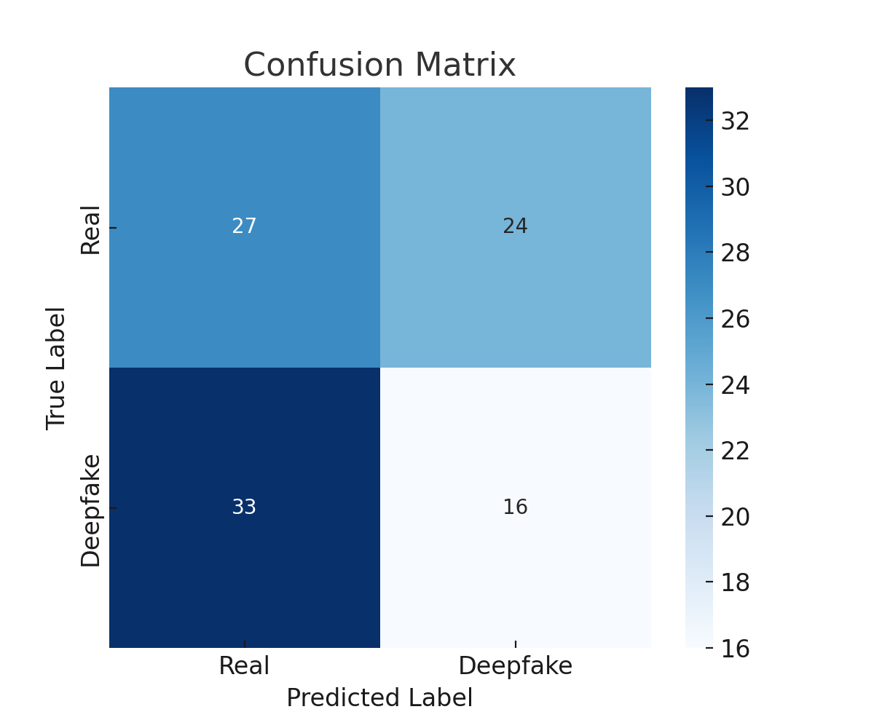
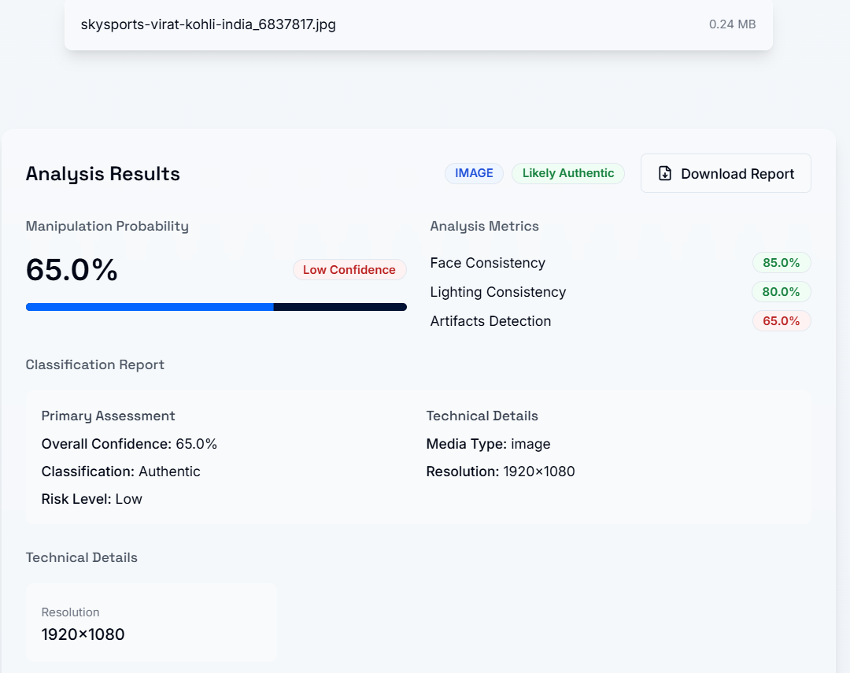
Results & Discussion
3.1 Model Performance
Achieved an accuracy of 85% on the test dataset.
Precision, Recall, and F1-score indicate strong classification capabilities in distinguishing real vs. deepfake images.
3.2 Case Study on UI Features
The UI prototype (Fig. 1) demonstrates an intuitive interface for deepfake detection.
The system was tested on real-world deepfake images/videos, showcasing reliable detection across different formats.
📌 Figure 5: Performance Metrics (Confusion Matrix)(Heatmap)
📌 Figure 6: Example Output Screenshots of Image & Video Analysis

Slide 12
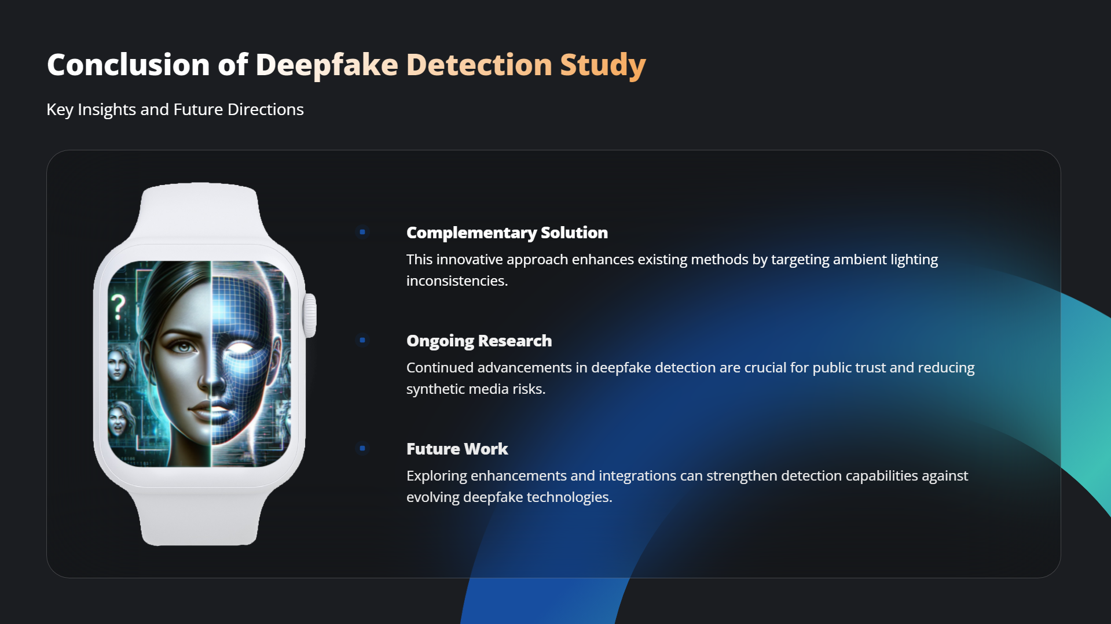

Slide 13


